Slide 1
CNS 2205
Network Programming
Linux Packet Capture and Traffic Control

Slide 2
Introduction to Packet Capture in Linux
What is Packet Capture?
  The process of intercepting and logging data packets.
Why Packet Capture?
  Network troubleshooting
  Performance analysis
  Security monitoring

Slide 3
Packet Capture Library - libpcap
What is libpcap?
  libpcap is a foundational library for network packet capture and filtering.
  It provides a system-independent API for low-level network monitoring, making it possible to capture and analyze packets in user space without needing to modify the kernel.
  A C/C++ library for capturing network packets.
Applications of libpcap
  Tools like Wireshark and tcpdump rely on libpcap to collect packets.
  Intrusion detection systems (e.g., Snort) use libpcap for packet inspection.
  Supports packet filtering through Berkeley Packet Filter (BPF).

Slide 4
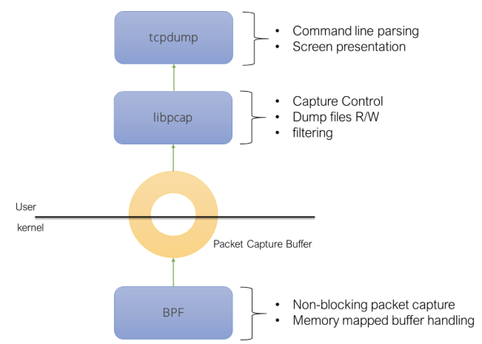
Packet Capture Library - libpcap

Slide 5
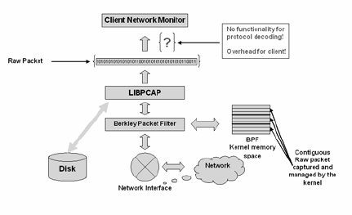
Packet Capture Library - libpcap

Slide 6
Components of libpcap
Packet Capture Mechanism:
  Captures packets by interacting with the kernel's network stack.
  Works in promiscuous mode to capture packets not destined for the host.
Filtering System:
  Uses Berkeley Packet Filters (BPF) to filter packets before they are delivered to user space.
  Filtering reduces overhead by selecting relevant packets directly at the kernel level.
User-Space Interface:
  Exposes functions to developers for starting and controlling packet capture sessions.

Slide 7
libpcap Workflow
Initialization:
  The application initializes a capture session using pcap_open_live() or similar functions.
  Specify the interface, snapshot length (packet size limit), and capture mode (promiscuous or not).
Packet Capture:
  libpcap interacts with the kernel to access raw packets via the socket interface.
  The kernel receives packets from the network and forwards them to libpcap.
Packet Filtering:
  A compiled BPF program is passed to libpcap using pcap_setfilter().
  Only packets matching the filter criteria are sent to user space, improving efficiency.

Slide 8
libpcap Workflow
Packet Delivery:
  Captured packets are delivered to the application via:
    Callback mechanism (pcap_loop())
    Manual polling (pcap_next() or pcap_next_ex())
Analysis and Processing:
  The application analyzes packet contents for various use cases, such as debugging, monitoring, or intrusion detection.
Termination:
  The session is closed with pcap_close(), releasing system resources.

Slide 9
Key Functions in libpcap
pcap_findalldevs():
  Lists all available interfaces for packet capture.
pcap_open_live():
  Opens a live capture session on a specified interface.
pcap_setfilter():
  Applies a BPF filter to limit captured traffic.
pcap_loop():
  Captures packets in a loop and invokes a user-defined callback.
pcap_dump_open() / pcap_dump():
  Saves captured packets to a file for later analysis.

Slide 10
Interaction with the Kernel
libpcap uses raw sockets to interface with the kernel.
On Linux, libpcap often uses the PF_PACKET socket type for efficient packet capture.
The kernel passes raw frames (including headers and payload) to libpcap for further processing.

Slide 11
Filtering with Berkeley Packet Filter (BPF)
What is BPF?
  A highly efficient, assembly-like filtering language.
  Allows libpcap to offload filtering tasks to the kernel.
How It Works:
  Developers define filters (e.g., tcp port 80).
  Filters are compiled into a BPF bytecode program using pcap_compile().
  The kernel executes the BPF program, returning only matching packets.

Slide 12
Packet Capture Tools - tcpdump
Command-line tool for capturing and analyzing packets.
Common commands:
  Capture traffic on a specific interface:
    tcpdump -i <interface>
  Save packets to a file:
    tcpdump -w <file>.pcap
  Read saved packets:
    tcpdump -r <file>.pcap
Filtering examples:
  Capture HTTP traffic:
    tcpdump port 80
  Capture traffic from a specific IP:
    tcpdump host <IP>

Slide 13
Traffic Control and Analysis in Linux
Traffic Control Overview
  Control, prioritize, and shape network traffic.
  Tools: tc (traffic control command).
Basic tc Commands
  View current traffic rules:
    tc qdisc show
  Add a bandwidth limit:
    tc qdisc add dev <interface> root tbf rate 1mbit latency 50ms burst 1540
  Delete traffic control rules:
    tc qdisc del dev <interface> root
Traffic Analysis
  Monitor network usage:
    iftop: Real-time traffic on an interface.
    nload: Bandwidth usage visualization.
    ip -s link: View packet statistics per interface.

Slide 14
Use Cases
Security:
  Intrusion detection and monitoring.
  E.g. Snort tool
Performance:
  Identifying bottlenecks.
  E.g. ntop tool
Troubleshooting:
  Resolving connectivity issues.

